Slide 1

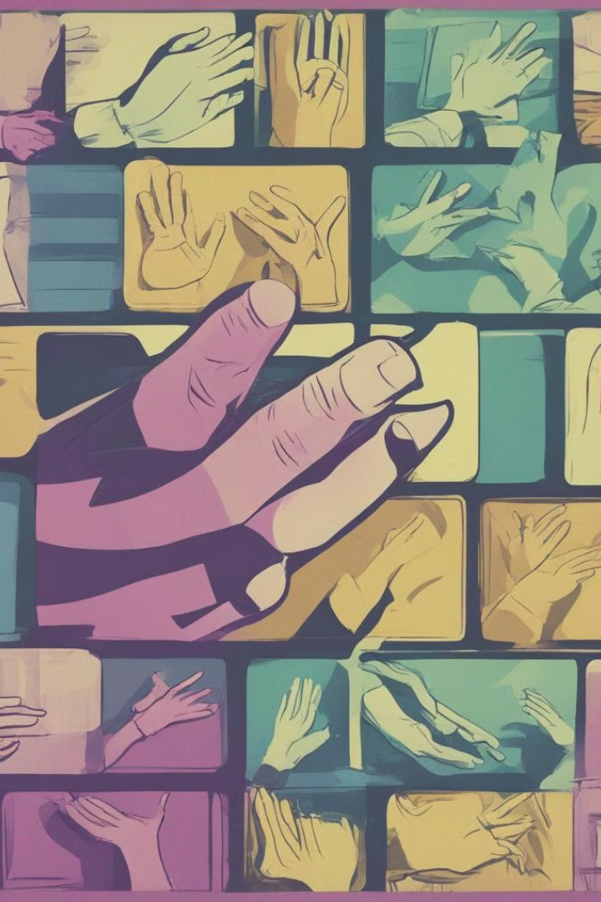
Real Time Sign Language Translation
Sign language is a natural form of communication.

Slide 2

Why Sign Language Translation is Important
There are 1 million Deaf people who use American Sign Language as their primary language.
30 million Americans have hearing impairment at 40 decibels (dB) or higher. "Normal" hearing ranges from 0 to 20 dB.
There are 70 million Deaf people around the world who use sign language.
98% of Deaf people worldwide do not receive education in their own language.
72% of families do not use sign language with their Deaf children.
70% of Deaf people are either unemployed or underemployed.
1 in 4 Deaf people have quit a job due to discrimination.

Slide 3
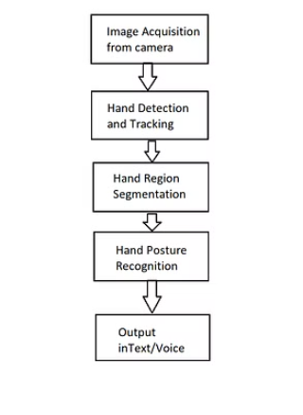
Process of sign to text
Hand Detection and Tracking
Gesture Recognition
Mapping to Text
Output

Slide 4
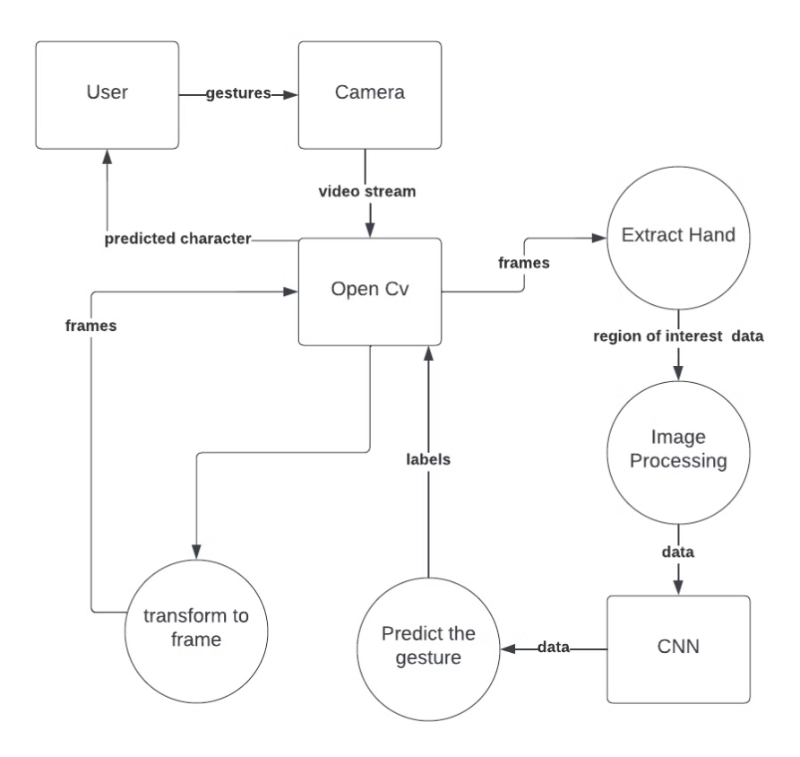
Data Flow Diagram

Slide 5
Data Acquisition Methods
Electromechanical Devices
Vision-Based Methods
Provide exact hand configuration and position.
Utilizing computer webcams for natural interaction without extra devices.

Slide 6

Data Pre-processing and Feature Extraction
1
Hand Detection
2
Image Pre-processing
3
Challenges
Utilizing media pipe library for image processing and hand detection.
Overcoming limitations of background and lighting conditions for accurate results.
Converting images to gray scale and applying filters for feature extraction.

Slide 7



Gesture Classification with CNN
CNN
Neural Networks
Feature Detection
Highly useful for solving computer vision problems.
Inspired by the actual perception of vision in the brain.
Identifying low to high level features in hand gestures.

Slide 8
Accuracy and Results
97%
99%
Accuracy
Optimal Conditions
Obtained through the proposed method for gesture classification.
Results achieved with clear background and good lighting conditions.

Slide 9

Text To Speech Translation
Translation
Library Usage
Converting recognized gestures into words and speech.
Utilizing pyttsx3 library for text-to-speech conversion.
Real-life Dialogue
Simulating a real-life conversation through text-to-speech output.

Slide 10




Project Requirements
Hardware
Software
System Diagrams
Webcam for capturing hand gestures.
Python 3.9, OpenCV, NumPy, Keras, Tensorflow for development.
Flowchart, Use-case diagram, DFD diagram, Sequence diagram.

Slide 11
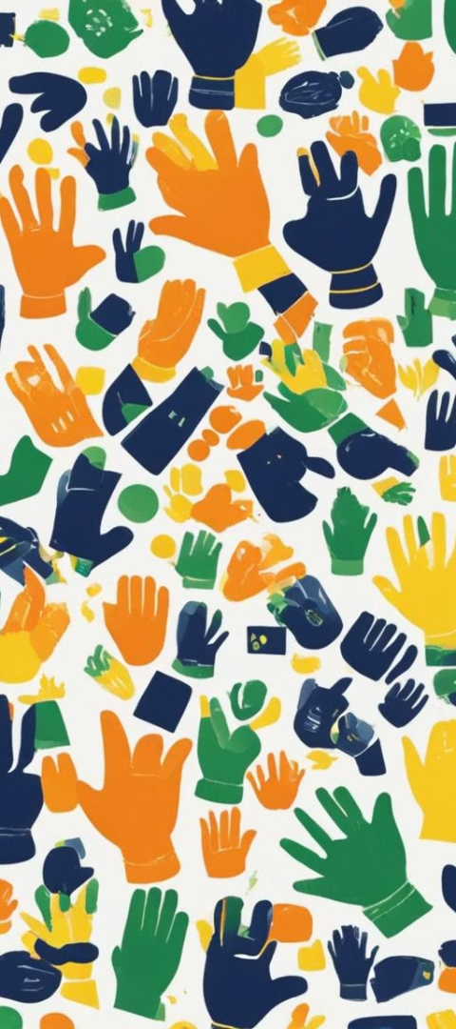
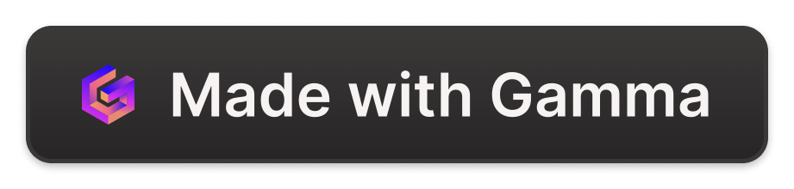
Challenges in Hand Gesture Recognition
1
Variability
Coping with large variability in hand appearance and movements.
2
Lighting Conditions
Dealing with variations in lighting conditions for accurate detection.
3
Background
Overcoming challenges of background interference for accurate recognition.

Slide 12
About the Application
Language
English (US)
IDE
PyCharm
Programming Language
Python 3.9

